Slide 1
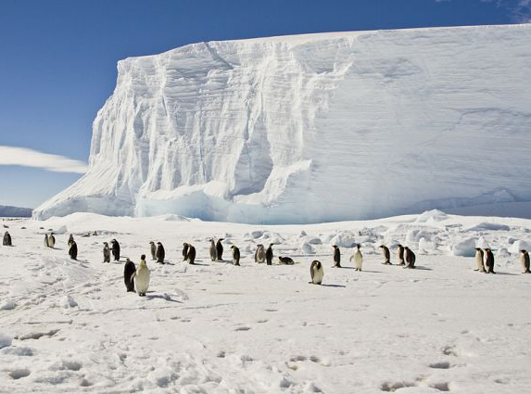


Slide 2
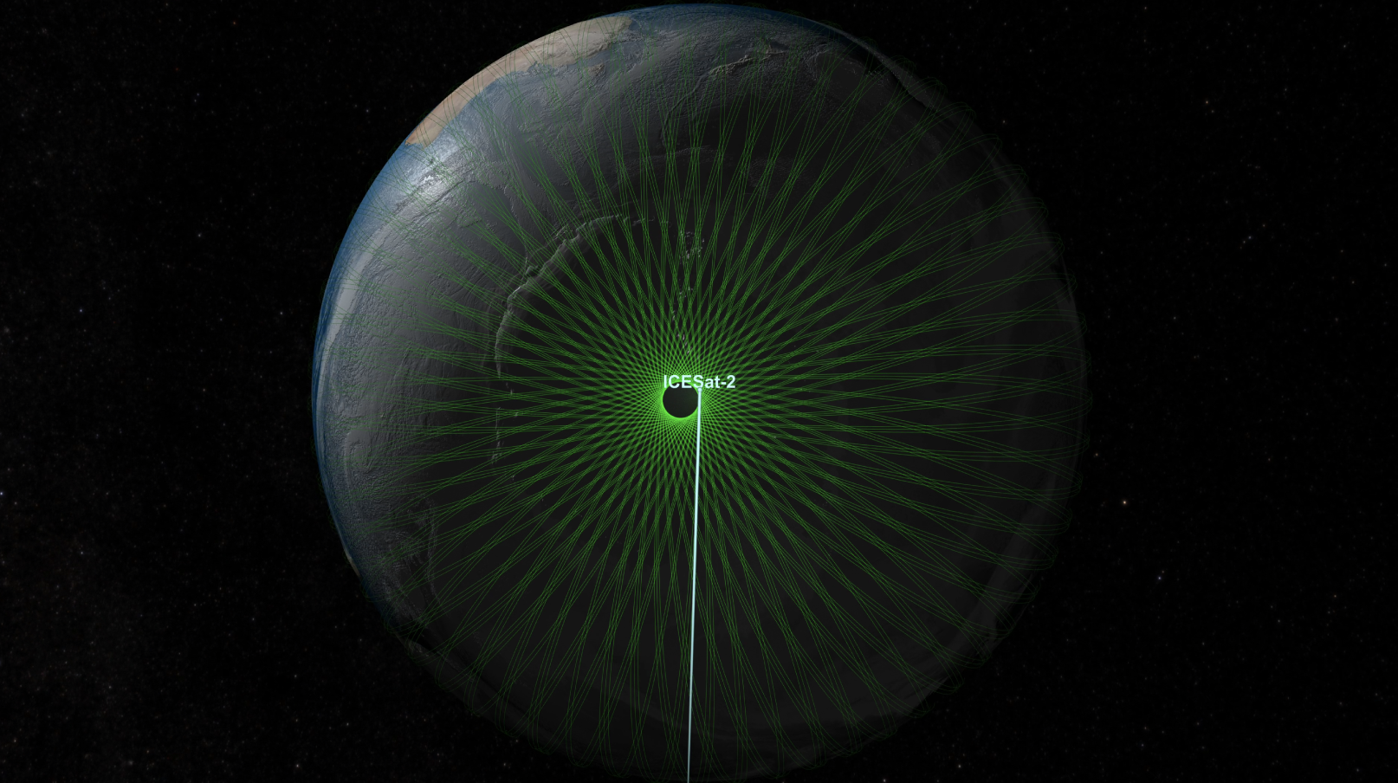
Green light - 532.272 nm
91-day revisit
Ground tracks at icesat-2.gsfc.nasa.gov
The Basics

Slide 3
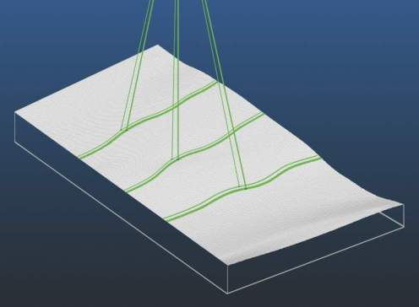
6 beams
flight direction
flight direction
3 km
3 km
3 km
3 km
90 m
Left = weak beam
Right = strong beam
high-energy beams (4x) for better performance over low-reflectivity targets.

Slide 4
Data products
Product | What? | Resolution / posting | Volume Points / 10x10 km box
ATL03 | Geolocated photon-returns | 0.7 m / 0.7 m | >6,000,000 / yr
ATL06 | Surface-height estimates for along-track segments | 40 m / 20 m | 32,000 / yr
ATL11 | Surface height corrected to reference tracks | 120 m / 60 m @ 4/yr | 2,600 reference points 10,400 data points
ATL14 | DEM | 125 m -3 km / 125 m @1/yr | 6400
ATL15 | dh/dt maps | 500 m – 3 km m, 500 m @4/yr | 1600/yr

Slide 5
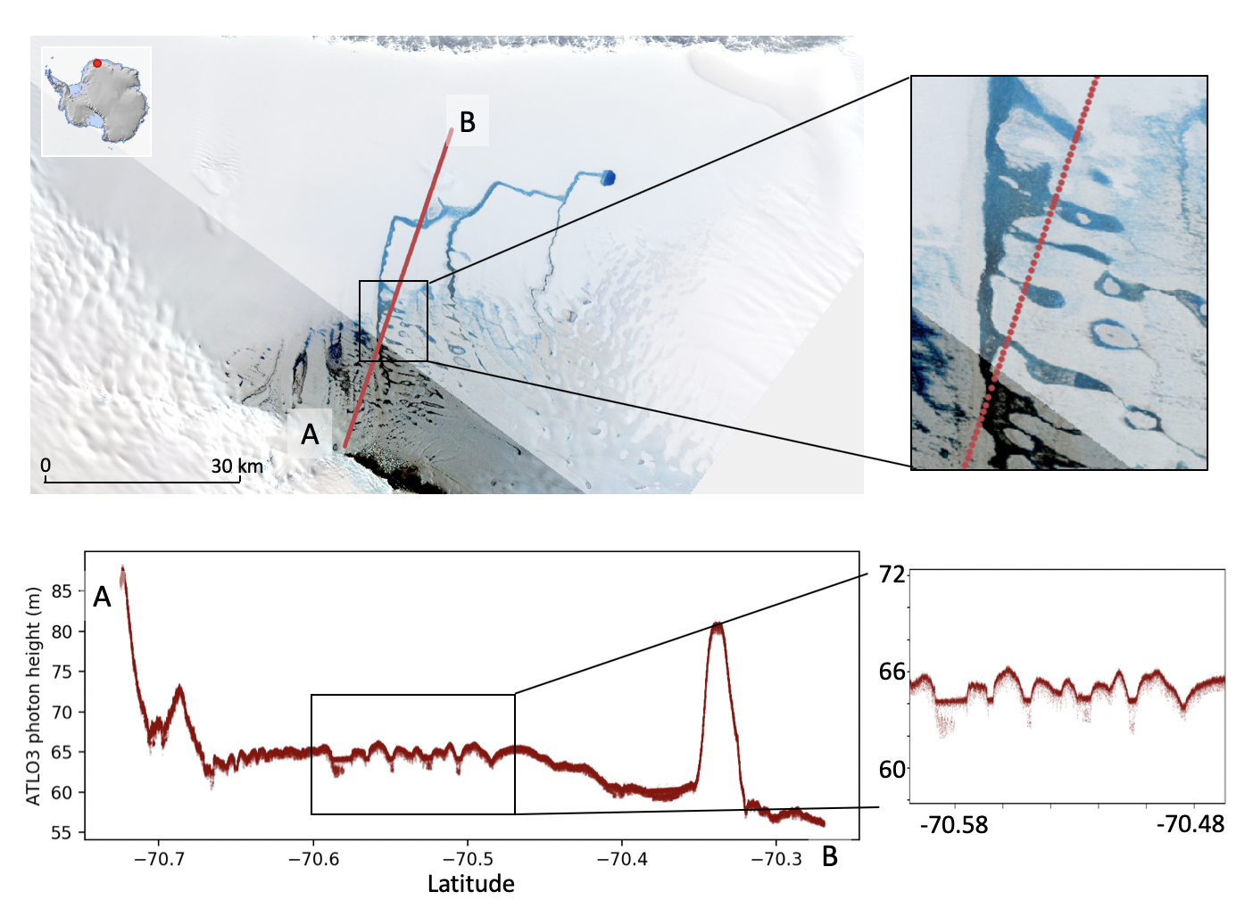
ATLO3 example

Slide 6
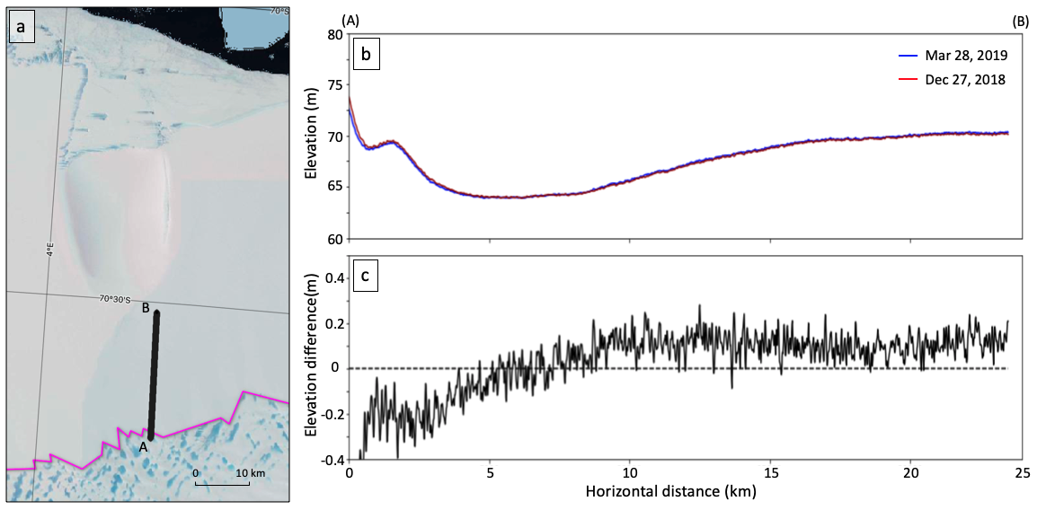
ATLO6 example

Slide 7
Where to learn more
The ICESat-2 webpage (https://icesat-2.gsfc.nasa.gov):
Links to the Algorithm Theotretical Basis Documents:
KMLs of ground-track locations (under Tech Specs)
Animations
The NSIDC landing page (https://nsidc.org/data/icesat-2):
Product format descriptions
Data file naming conventions
News on data releases
Known issue descriptions
Data(!)

